Slide 1


Addressing Modes & Instruction Set in 8085
Presented by
Mahbubur Rahman
Lecturer
Department of Computer Science and Engineering(CSE)
Green University of Bangladesh(GUB)

Slide 2
Outline
02
8085 μP – Functional Units
Instruction Set of 8085 μP
8085 Addressing Modes
Peripherals
Interrupts in 8085

Slide 3
8085 μP – Functional Units
03

Slide 4
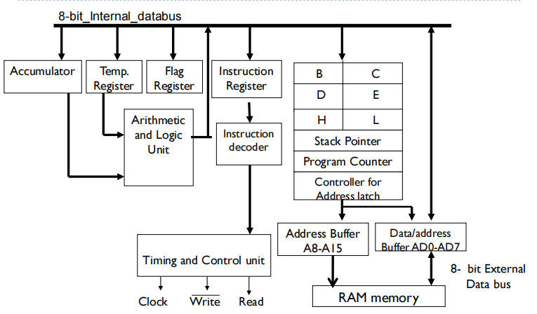
8085 μP – Functional Units (Architecture)
04

Slide 5
8085 μP – Functional Units (1/5)
05
Accumulator: It is an 8-bit register used to perform arithmetic, logical, I/O & LOAD/STORE operations. It is connected to internal data bus & ALU.
Arithmetic and logic unit: As the name suggests, it performs arithmetic and logical operations like Addition, Subtraction, AND, OR, etc. on 8-bit data.
General purpose register: There are 6 general purpose registers in 8085 processor, i.e. B, C, D, E, H & L. Each register can hold 8-bit data. These registers can work in pair to hold 16-bit data and their pairing combination is like B-C, D-E & H-L.

Slide 6
8085 μP – Functional Units (2/5)
06
Program counter(PC): It is a 16-bit register used to store the memory address location of the next instruction to be executed. Microprocessor increments the program whenever an instruction is being executed, so that the program counter points to the memory address of the next instruction that is going to be executed.
Stack pointer(SP): It is also a 16-bit register works like stack, which is always incremented/decremented by 2 during push & pop operations.
Temporary register: It is an 8-bit register, which holds the temporary data of arithmetic and logical operations.

Slide 7
8085 μP – Functional Units (3/5)
07
Instruction register and decoder: It is an 8-bit register. When an instruction is fetched from memory then it is stored in the Instruction register. Instruction decoder decodes the information present in the Instruction register.
Timing and control unit: It provides timing and control signal to the microprocessor to perform operations. Following are the timing and control signals, which control external and internal circuits −
Control Signals: READY, RD’, WR’, ALE
Status Signals: S0, S1, IO/M’
DMA Signals: HOLD, HLDA
RESET Signals: RESET IN, RESET OUT

Slide 8
8085 μP – Functional Units (4/5)
08
Interrupt control: As the name suggests it controls the interrupts during a process. When a microprocessor is executing a main program and whenever an interrupt occurs, the microprocessor shifts the control from the main program to process the incoming request. After the request is completed, the control goes back to the main program.
There are 5 interrupt signals in 8085 microprocessor: INTR, RST 7.5, RST 6.5, RST 5.5, TRAP.

Slide 9
8085 μP – Functional Units (5/5)
09
Address buffer and address-data buffer: The content stored in the stack pointer and program counter is loaded into the address buffer and address-data buffer to communicate with the CPU. The memory and I/O chips are connected to these buses; the CPU can exchange the desired data with the memory and I/O chips.
Address bus and data bus: Data bus carries the data to be stored. It is bidirectional, whereas address bus carries the location to where it should be stored and it is unidirectional. It is used to transfer the data & Address I/O devices.

Slide 10
Instruction Set of 8085 μP
10

Slide 11
Instruction Set of 8085 Microprocessor
11
An instruction is a binary pattern designed inside a microprocessor to perform a specific function. An instruction is a command given to the microprocessor to perform a specific operation on data.
The entire group of instructions that a microprocessor supports is called Instruction Set.
8085 has 246 instructions.
Each instruction is represented by an 8-bit binary value.
These 8-bits of binary value is called Op-Code or Instruction Byte.

Slide 12
Instruction Set of 8085 Microprocessor
12
Basically there are five groups of instructions:
Data transfer instructions: These instructions are used to transfer the data from one register to another register, or memory to register etc.
Arithmetic instructions: These instructions are going to perform arithmetic operations like addition, subtraction etc.
Logical instructions: These instructions are going to perform logical operations like AND, OR, XOR etc.
Branching instructions: These instructions are going to design inside the program controller where we need to jump the program control. Example: JUMP, CALL, RETURN etc.
I/O and Machine control instructions: These instruction contains I/O and machine related contents.

Slide 13
Data transfer instructions
13
These are used for data transfer from one place to another place.
M = memory
R = Register
SP = Stack
Pointer
Instruction | Operation | Explanation
MOV R1, R2 | R1 ← R2 | Data moves from R2 to R1
MOV M, R (M points to HL register pair) | M ← R | Data moves from R to M. Address of Memory data is loaded in HL register pair.
MOV R, M | R ← M | Data moves from M to R
MVI R, FFH (Move Immediate Data) | R ← FFH | FFH moves to R
MVI M, 8-bit data | M ← 8-bit data | 8-bit data moves to M
LXI SP, 8-bit data (stack initialization) | SP ← 8-bit data | 8-bit data moves to SP

Slide 14
Arithmetic Instructions: Addition
14
Instruction | Operation | Explanation
ADD R | A ← A + R | Add data from R with Accumulator data
ADD M | A ← A + M | Add data from M with Accumulator data
ADI 8-bit data (Add immediate data) | A ← A + 8 bit data | Add 8-bit data with Accumulator data
ADC R | A ← A + R + CY | Add data from R with Accumulator data, then add Carry flag
ADC M | A ← A + M + CY | Add data from M with Accumulator data, then add Carry flag
ADC 8-bit data | A ← A + 8 bit data + CY | Add 8-bit data with Accumulator data, then add Carry flag
M = memory
R = Register
CY = Carry Flag

Slide 15
Arithmetic Instructions: Subtraction
15
Instruction | Operation | Explanation
SUB R | A ← A - R | Subtract R value from Accumulator
SUB M | A ← A - M | Subtract M value from Accumulator
SUI 8-bit data (Subtract immediate data) | A ← A - 8 bit data | Subtract 8 bit data from Accumulator
SBB R | A ← A - R - CY | Subtract R value from Accumulator, then subtract Carry flag
SBB M | A ← A - M - CY | Subtract M value from Accumulator, then subtract Carry flag
SBI 8-bit data | A ← A - 8 bit data - CY | Subtract 8 bit data from Accumulator, then subtract Carry flag
M = memory
R = Register
CY = Carry Flag
SBB = Subtract with borrow

Slide 16
Arithmetic Instructions: Increment Decrement
16
Instruction | Operation | Explanation
INR R | R ← R + 1 | Add 1 with the R value
INR M | M ← M + 1 | Add 1 with the M value
DCR R | R ← R - 1 | Subtract 1 from R
DCR M | M ← M - 1 | Subtract 1 from M
INX rp | rp ← rp + 1 | INX B = increment value of BC register pair.
DCX rp | rp ← rp - 1 | DCX B = Decrement value of BC register pair.
M = memory
R = Register
rp = register pair

Slide 17
Logical Instructions( AND, OR)
17
Instruction | Operation | Explanation
ANA R | A ← A ^ R | AND operation between A and R
ANA M | A ← A ^ M | AND operation between A and M
ANI 8-bit data | A ← A ^ 8 bit data | AND operation between A and 8 bit data
ORA R | A ← A ∨ R | OR operation between A and R
ORA M | A ← A ∨ M | OR operation between A and M
ORI 8-bit data | A ← A ∨ 8 bit data | OR operation between A and 8 bit data
M = Memory
R = Register
A = Accumulator

Slide 18
AND, OR, XOR Examples
18
 | 1 | 0 | 1 | 1 | 0 | 0 | 1 | 1 |  |  |  | 1 | 0 | 1 | 1 | 0 | 0 | 1 | 1 |  |  |  | 1 | 0 | 1 | 1 | 0 | 0 | 1 | 1
˅ | 0 | 1 | 0 | 0 | 1 | 0 | 0 | 1 |  |  | ˄ | 0 | 1 | 0 | 0 | 1 | 0 | 0 | 1 |  |  | ⊕ | 0 | 1 | 0 | 0 | 1 | 0 | 0 | 1
 | 1 | 1 | 1 | 1 | 1 | 0 | 1 | 1 |  |  |  | 0 | 0 | 0 | 0 | 0 | 0 | 0 | 1 |  |  |  | 1 | 1 | 1 | 1 | 1 | 0 | 1 | 0

Slide 19
Logical Instructions( XOR, COMPARE)
19
Instruction | Operation | Explanation
XRA R | A ← A ⊕ R | XOR operation between A and R
XRA M | A ← A ⊕ M | XOR operation between A and M
XRA 8-bit data | A ← A ⊕ 8 bit data | XOR operation between A and 8 bit data
CMP R (Z, CY) | A - R | Subtract R value from Accumulator. Do not save. Only flag values are changed.
CMP M | A - M | Subtract M value from Accumulator. Do not save. Only flag values are changed.
CPI 8-bit data | A - 8 bit data | Subtract 8 bit data from Accumulator. Do not save. Only flag values are changed.
M = Memory
R = Register
A = Accumulator

Slide 20
Logical Instructions(ROTATE, COMPLEMENT)
20
Instruction | Operation | Explanation
RLC | Rotate Left without carry | Rotates the Accumulator value
RRC | Rotate Right without carry | Rotates the Accumulator value
RAL | Rotate Left with carry | Rotates the Accumulator value
RAR | Rotate Right with carry | Rotates the Accumulator value
CMA | Complement Accumulator | Accumulator value will change
CMC | Complement Carry | Carry flag will change
M = memory
R = Register

Slide 21
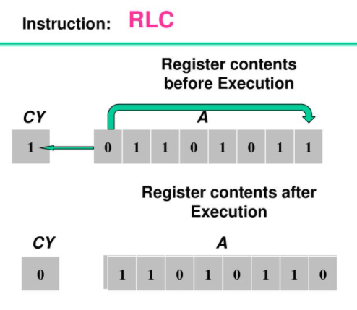
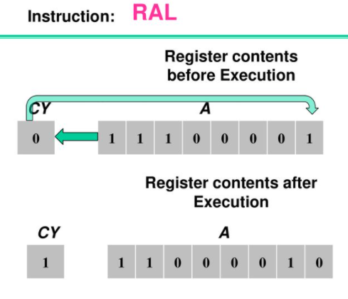
ROTATE (RLC, RAL)
21

Slide 22
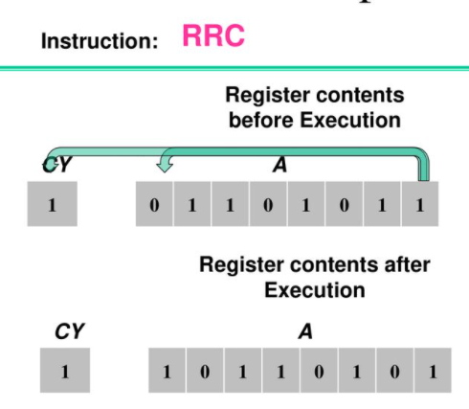
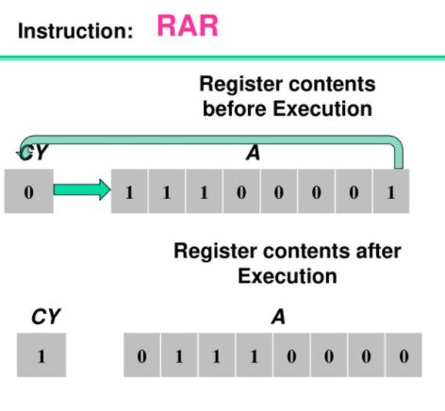
ROTATE (RRC, RAR)
22

Slide 23
Branching Instructions
23
Jump (Unconditional and Conditional): Example: JUMP 16 bit address
Call (Unconditional and Conditional): Example: CALL 16 bit address (PUSH)
Return (Unconditional and Conditional): Example: RET (POP)
Condition depends on flag registers.
In every JUMP instruction Program counter (PC) is going to catch the 16 bit address
Ex: JNZ, JZ, JC, JNC, JPE, JPO, JP, JM
In every CALL instruction Stack Pointer (SP) is decremented by 2
Ex: CNZ, CZ, CC, CNC, CPE, CPO, CP, CM
In every RET instruction Stack Pointer (SP) is incremented by 2
Ex: RNZ, RZ, RC, RNC, RPE, RPO, RP, RM
NZ (Z=0)
Z (Z=1)
C (C=1)
NC (C=0)
PE (P=1)
PO (P=0)
P(Plus) (S=0)
M(Minus) (S=1)

Slide 24
Stack, I/O and Machine Control Instructions
24
This category have total 10 instructions into 3 categories.
Stack:
I/O:
Machine Control:
PUSH: Push two bytes of data into stack.
POP: Pop two bytes of data from stack.
HTHL: Exchange top of stack with HL.
SPHL: Move contents of HL to stack.
IN: Initiate input operation. Example: IN 8 bit data A ← 8 bit data
OUT: Initiate output operation. Example: OUT 8 bit data A ➡ 8 bit data
EI: Enable interrupt All interrupts are enabled
DI: Disable interrupt RST 7.5, 6.5, 5.5 and INTR will be disabled
HLT: Microprocessor is halted
NoP: No operation

Slide 25
8085 Addressing Modes
25

Slide 26
Addressing Modes in 8085
26
These are the instructions used to transfer the data from one register to another register, from the memory to the register, and from the register to the memory without any alteration in the content. The various formats for specifying operands are called addressing modes. The different ways that a microprocessor can access data. The way the operands are chosen during execution of an instruction is determined by addressing modes. Addressing modes in 8085 is classified into 5 groups −
Immediate addressing mode
Register addressing mode
Direct addressing mode
Indirect addressing mode
Implicit/Implied addressing mode

Slide 27
Addressing Modes in 8085 (1/5)
27
Immediate addressing mode: 8 or 16 bit data can be specified as a part of instruction. Data is present in the instruction itself. Whenever the symbol I is present in the instruction then it is an immediate addressing mode. Example:
MVI B, 33H; | Move immediate 33H data into B register
MVI M, 7CH; | 7CH is copied into memory “M”
LXI D, 245EH; | 24H is copied to D and 5E is copied to E register
ADI 87H; | 87+A → A

Slide 28
Addressing Modes in 8085 (2/5)
28
Register addressing mode: In this mode, the data is copied from one register to another. Example:
MOV A,B; | the content of B will be move to A register
ADD E; | E+A → A
SP H, L; | contents of H and L will be store in the top of the stack.

Slide 29
Addressing Modes in 8085 (3/5)
29
Direct addressing mode: In this mode, the data is directly copied from the given address to the register. It specifies 16-bit address of the operand within instruction itself. Example:
LDA 6000H; | load accumulator with data present at 6000H

Slide 30
Addressing Modes in 8085 (4/5)
30
Indirect addressing mode: Address of the data is present as content of another register pair. The data is transferred from one register to another by using the address pointed by the register. Example:
MOV A, M; | move the contents of the memory location pointed by the H-L pair to the accumulator
LDAX B | move contents of B-C register to the accumulator

Slide 31
Addressing Modes in 8085 (5/5)
31
Implicit/Implied addressing mode: This mode doesn’t require any operand. Opcode specifies the address of operand. But some kind of operation is performed by the instruction and two operations may be performed in single register. Example:
CMA; | Complement the content of Accumulator (70 → 8F)
STC; | Set Carry Flag
RAL; | Rotate Accumulator Left

Slide 32
Peripherals
32

Slide 33
Peripherals
33
Peripherals are connected to microprocessor by two modes: Memory mapped I/O mode (I/O devices are treated as memory ICs) and I/O mapped I/O mode (I/O devices are treated as I/O)
 | Memory mapped I/O |  | I/O mapped I/O
Number of Address lines | 16 for memory 16 for I/O |  | 16 (for memory) | 8 (for I/O)
Control Signals | MEMR’ MEMW’ |  | MEMR’ MEMW’ | IOR’ IOW’
Number of peripherals | 2¹⁶ = 64 KB Mem+I/O |  | 64 KB | 2⁸ = 256 I/O
It can address | 64 KB |  | 64 KB | 2⁸ = 256 I/O

Slide 34
Memory mapped I/O
34
Advantages:
IO/M’ is not required. So no separate instructions are needed.
Arithmetic, logical operations can be directly performed on I/O data.
Disadvantages:
Interfacing is complex.
Memory space required is high.
More decoder hardware required.

Slide 35
I/O mapped I/O
35
Advantages:
Interfacing is less complex.
Required less decoder hardware.
Maximum capacity of microprocessor will be utilized.
Disadvantages:
I/O devices require separate instructions.
Arithmetic, logical operations can’t be performed on I/O data.
4 control signals required.

Slide 36
Interrupts in 8085
36

Slide 37
Interrupts in 8085
37
Interrupts are the signals generated by the external devices to request the microprocessor to perform a task. There are 5 interrupt signals, i.e. TRAP, RST 7.5, RST 6.5, RST 5.5, and INTR. Interrupt are classified into following groups based on their parameter:
Vector interrupt: In this type of interrupt, the interrupt address is known to the processor. For example: RST7.5, RST6.5, RST5.5, TRAP.
Non-Vector interrupt: In this type of interrupt, the interrupt address is not known to the processor so, the interrupt address needs to be sent externally by the device to perform interrupts. For example: INTR.
Maskable interrupt: In this type of interrupt, we can disable the interrupt by writing some instructions into the program. For example: RST7.5, RST6.5, RST5.5.
Non-Maskable interrupt: In this type of interrupt, we cannot disable the interrupt by writing some instructions into the program. For example: TRAP.
Software interrupt: In this type of interrupt, the programmer has to add the instructions into the program to execute the interrupt. There are 8 software interrupts in 8085, i.e. RST0, RST1, RST2, RST3, RST4, RST5, RST6, and RST7.
Hardware interrupt: There are 5 interrupt pins in 8085 used as hardware interrupts, i.e. TRAP, RST7.5, RST6.5, RST5.5, INTA.

Slide 38
Interrupt Service Routine (ISR)
38
A small program or a routine that when executed, services the corresponding interrupting source is called an ISR.
TRAP: It is a non-maskable interrupt, having the highest priority among all interrupts. By default, it is enabled until it gets acknowledged. In case of failure, it executes as ISR and sends the data to backup memory. This interrupt transfers the control to the location 0024H.
RST7.5: It is a maskable interrupt, having the second highest priority among all interrupts. When this interrupt is executed, the processor saves the content of the PC register into the stack and branches to 003CH address.
RST 6.5: It is a maskable interrupt, having the third highest priority among all interrupts. When this interrupt is executed, the processor saves the content of the PC register into the stack and branches to 0034H address.
RST 5.5: It is a maskable interrupt. When this interrupt is executed, the processor saves the content of the PC register into the stack and branches to 002CH address.

Slide 39
INTR
39
It is a maskable interrupt, having the lowest priority among all interrupts. It can be disabled by resetting the microprocessor.
When INTR signal goes high, the following events can occur:
The microprocessor checks the status of INTR signal during the execution of each instruction.
When the INTR signal is high, then the microprocessor completes its current instruction and sends active low interrupt acknowledge signal.
When instructions are received, then the microprocessor saves the address of the next instruction on stack and executes the received instruction.

Slide 40
Thank You
40

